Slide 1
The Plant Protector
By: David Myers and Beth Kraus
Notes:
dave

Slide 2
Outline
Overview/Goals
Background
System Operation/Block Diagram
BOM
Major Components
Methods (PCB)
Methods (Code)
Timeline
Progress
UML Activity Diagram
Demo
Notes:
dave

Slide 3
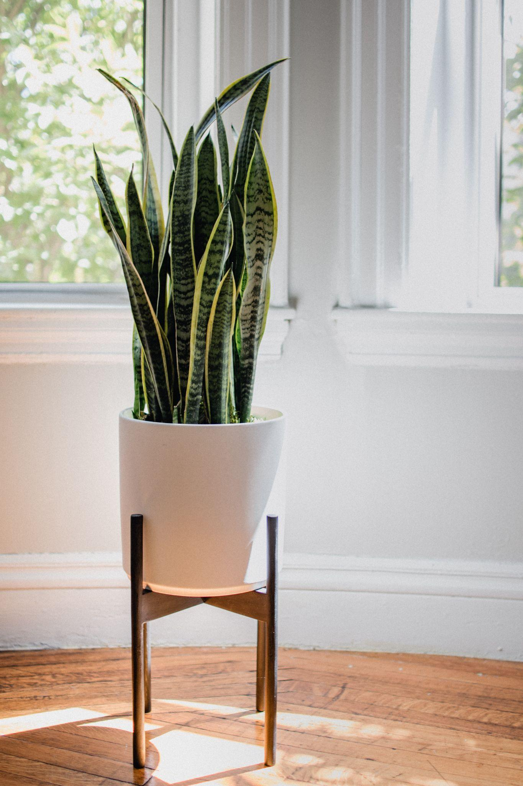
Overview/Goal
People easily forget about their house plants which leads to them dying
We designed a system that lets users know the problems their plant is facing
Uses sensors to read plant vitals
Notifies user of issues with buzzer and wifi notification
Image from: Unsplash.com
Notes:
dave

Slide 4
Background
Difficult to trace the first plant care system like this
Indoor plants provide several benefits to humans [1]
Cleaner air
Feeling calm
Reduce stress
Improved productivity
Plant care devices exist all over the world in different shapes and sizes
Advancing Eco Agriculture offers systems that helps plants by monitoring soil health [2]
[1] Acta Horticulturae
[2] about - Advancing Eco Ag
Notes:
beth

Slide 5
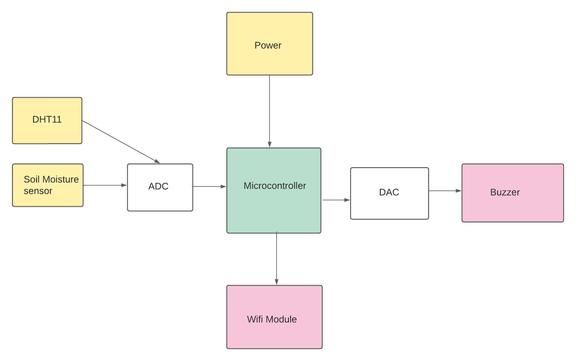
System Operation/Block Diagram
Plant Protector gives the user vitals of the plant it is connected to
Uses an MSP430 microcontroller for operation
Checks plants surrounding temperature and its soil moisture
Sensors feed data to the microcontroller
If the sensors relays data not within our set parameters two things occur:
Alarm on the module sounds
User gets a notification via wifi
Notes:
dave

Slide 6
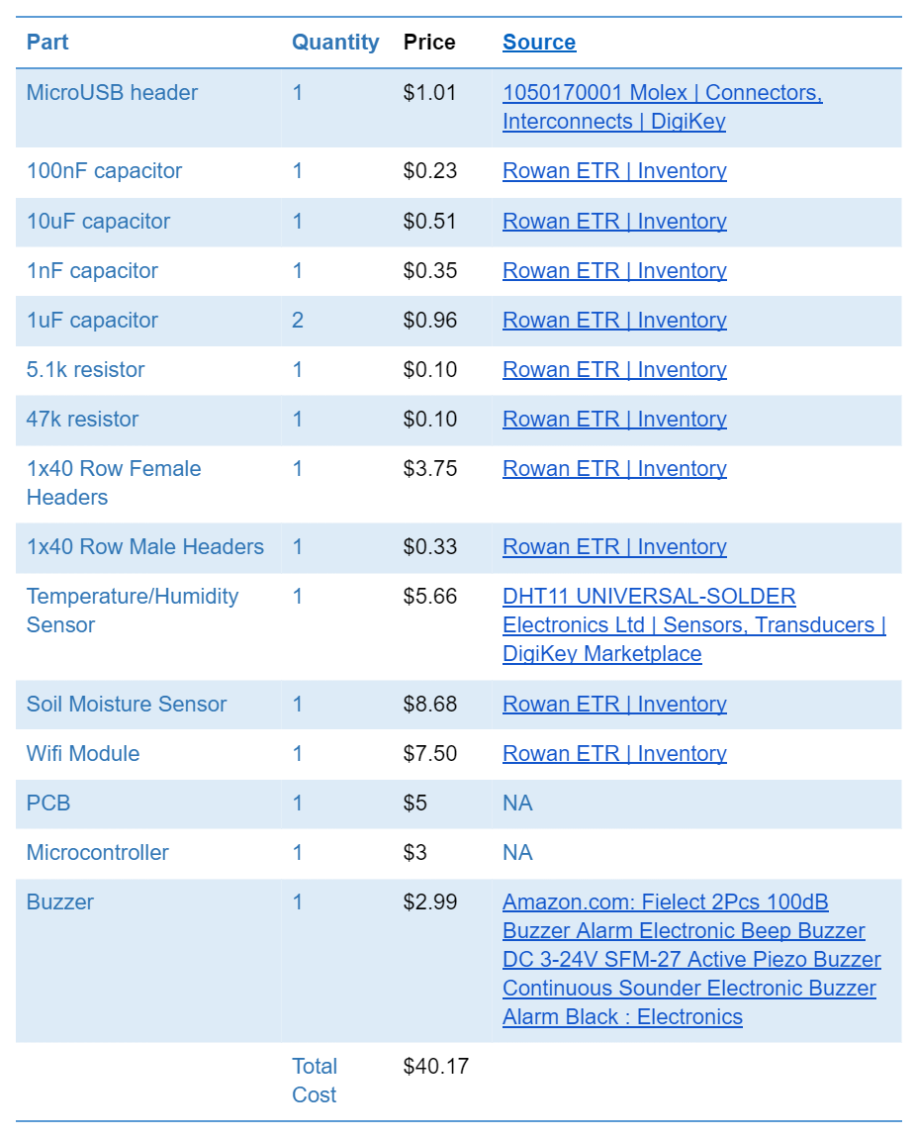
Bill of Materials
Primarily used school resources
Generally cheap components
Total cost was $40.17
Notes:
beth

Slide 7
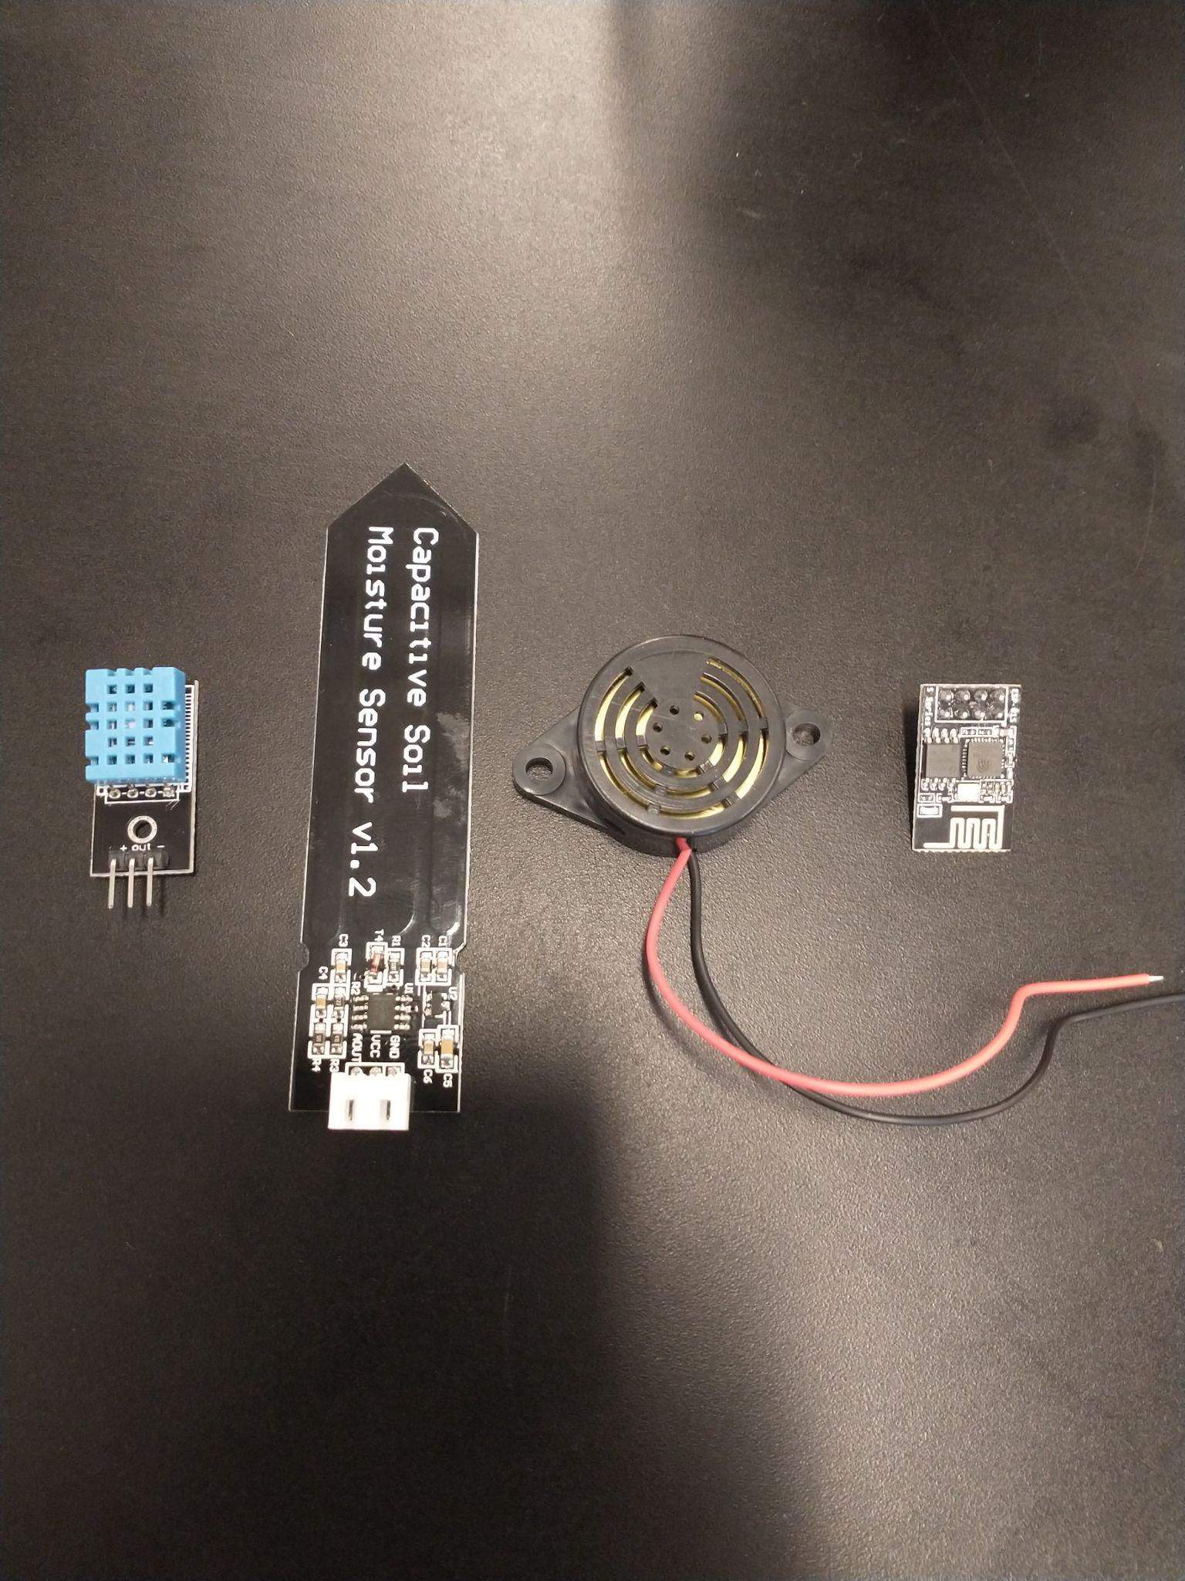
Major Components
(Components are displayed in order left to right)
DHT11: Temperature sensor. Chosen because of availability and compatibility with C coding.
EK1940: Soil moisture sensor. Chosen because of availability and ease of use.
Buzzer: Generic buzzer to act as a physical mean of communication to the user if the wifi fails.
ESP8266: Wifi Module. Allows us to wirelessly notify the user of plant issues. Chosen because of small form factor and user friendly.
Notes:
dave

Slide 8
Methods (PCB)
PCB underwent several revisions
1st design required MSP430 dev board. Design was scrapped early on for better options
2nd design was independent with MC soldered on. However used custom dimensions. Scrapped due to potential pick and place problems.
Final design used given schematic with modifications made. Allowed system to be independent and easy to work with.
Final Design Choices
Copper pour on back as ground layer. (reduced trace complexity)
Using provided schematic. (made project significantly easier going forward)
Independent System. (Only needs to be flashed and powered to operate. No dev board needed)
Notes:
dave

Slide 9
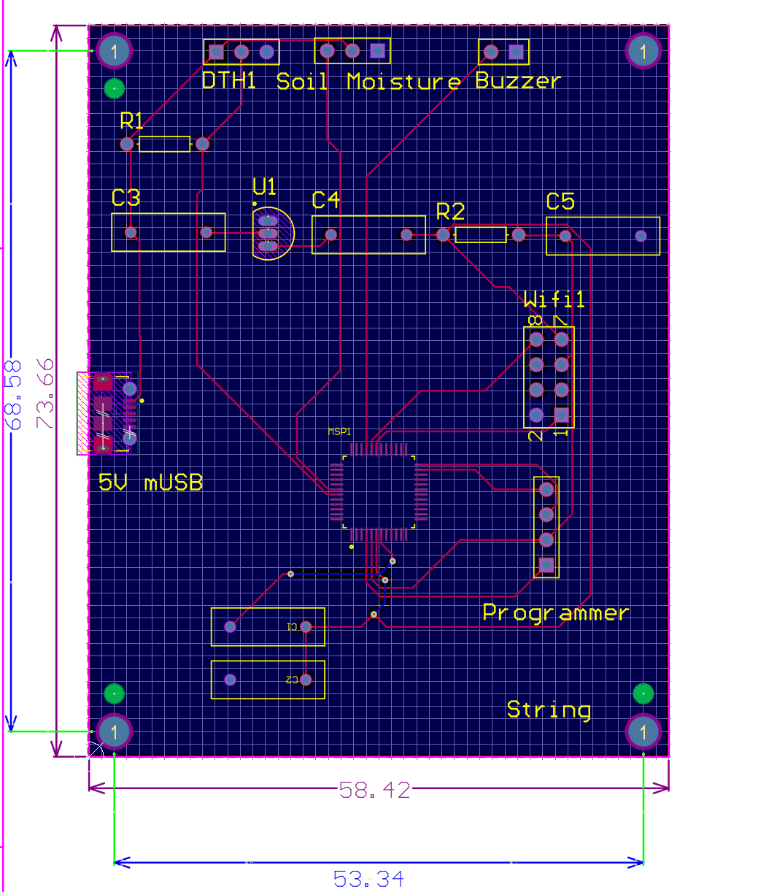
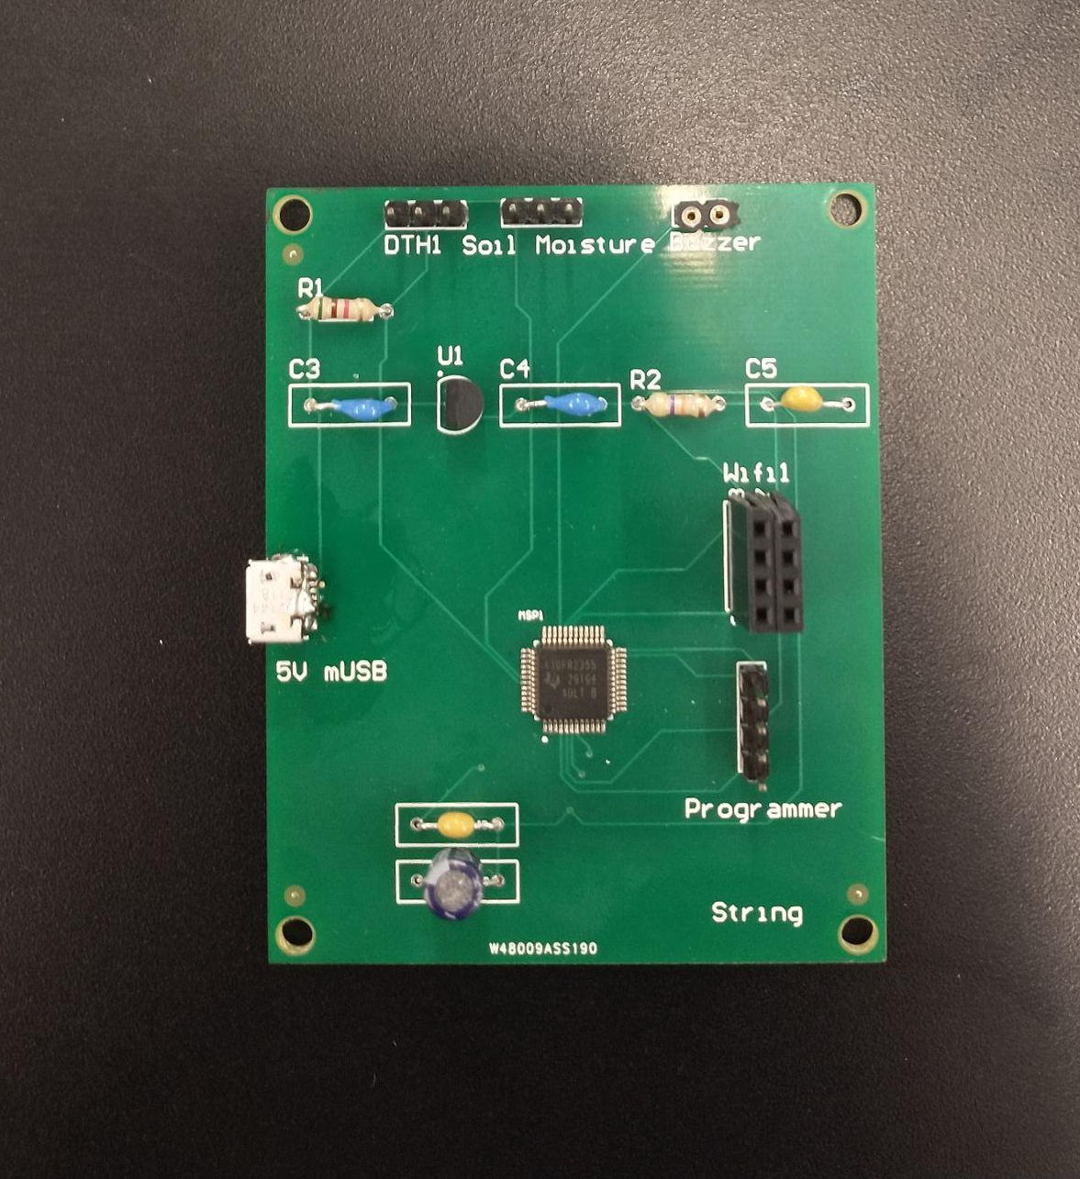
PCB

Slide 10
Methods (Code)
First, Initialize all GPIO Pins
Pin 1.7 = RX
Pin 1.6 = TX
Pin 1.5 = Buzzer
Pin 5.0 DHT 11
Pin 5.1 Soil Moisture
Starting and setting up a 2 channel ADC for the sensors
Starting and setting up the UART
UART sends data using the WIFI module
Interrupt with the following conditions in it
If the temperature goes below 16 C or above 30 C then the buzzer will go off
If the soil moisture goes below, 20 % or above 40 %, then the buzzer will go off
b-kraus/The-Plant-Proctector: To defend those plants in need (github.com)
Notes:
beth

Slide 11
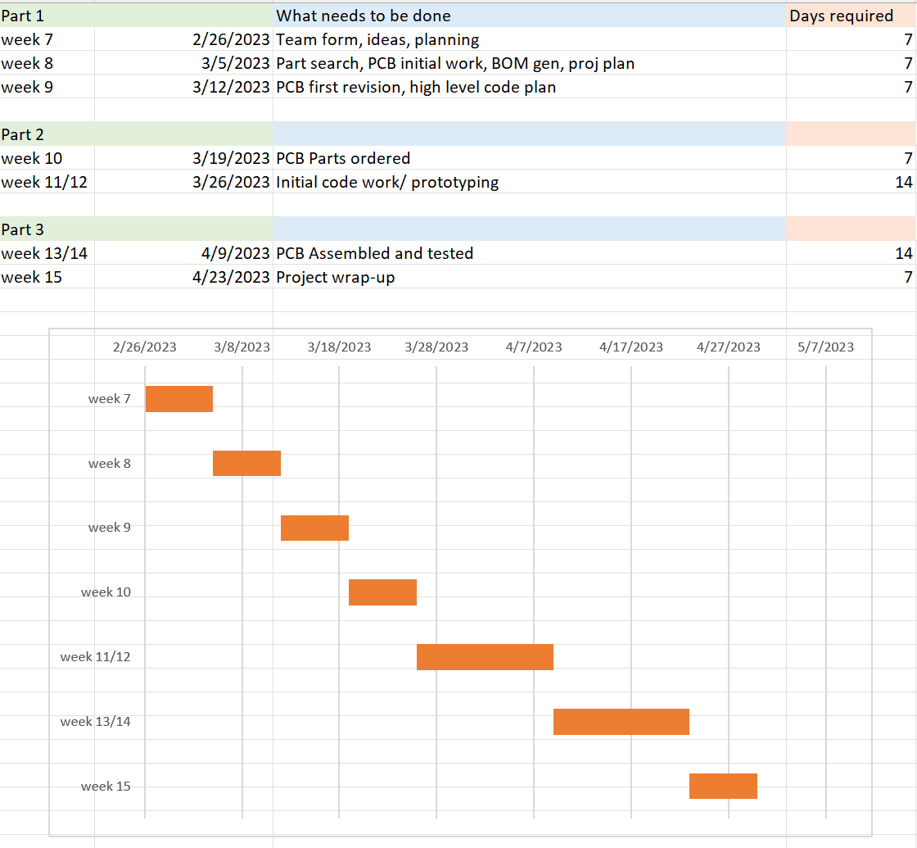
Timeline
Part 1: Planing, finding parts, 1st PCB revision
Part 2: Ordering parts, prototyping and code work begins
Part 3: Assembly and testing
Notes:
dave

Slide 12
Progress
Completed Tasks
PCB design
Components ordered
Assembly
Temperature and soil moisture readings
Remaining Tasks
Board needs a redesign
Wi-Fi (Thingspeak channel)
DHT11
Flashing board
Notes:
beth

Slide 13
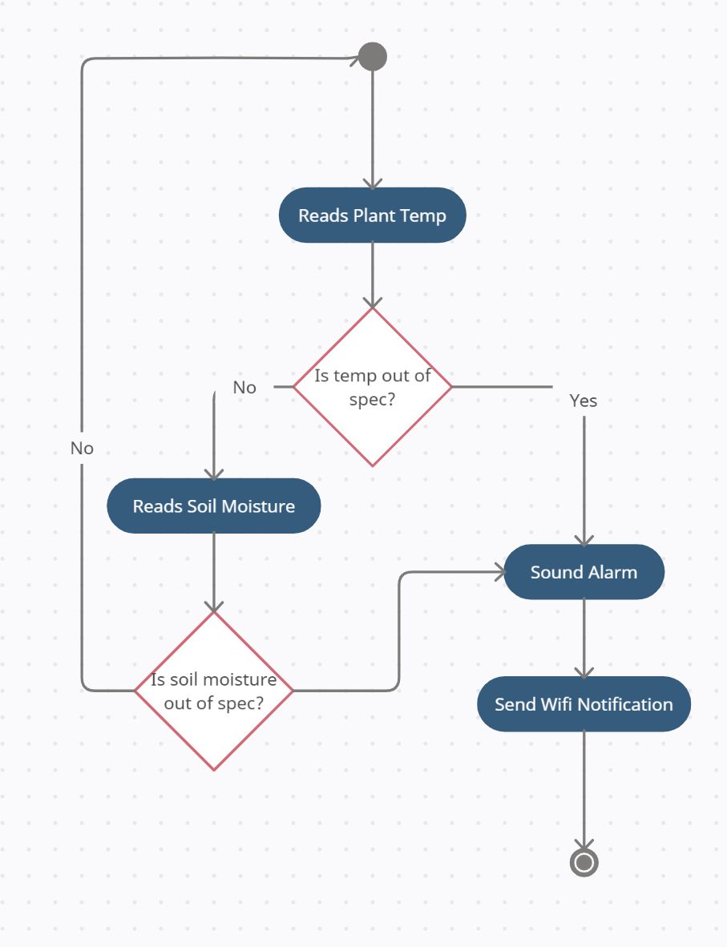
UML Activity Diagram
Notes:
beth

Slide 14
Demonstration
Notes:
dave

